Slide 1

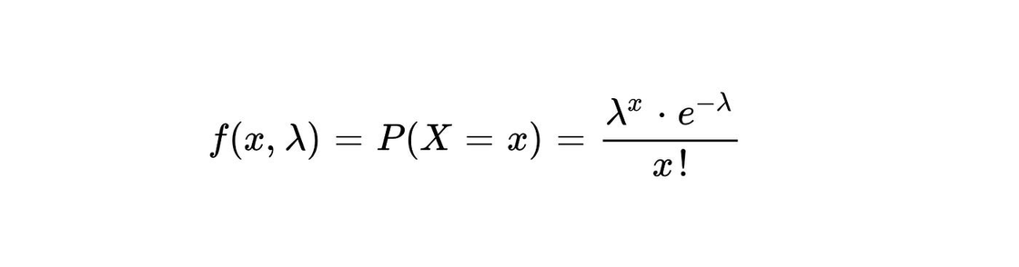


Poisson Distribution
Formula:
P(x) = the probability of x successes over a given period of time or space, given λ
λ = the expected number of successes per time or space unit; λ > 0
e = 2.71828 (the base for natural logarithms)
Example:
If new cases of COVID-19 in Africa are occurring at a rate of about 2 per month, then what’s the probability that exactly 4 cases will occur in the next 3 months?
X ~ Poisson (λ=2/month)
There is a 13.4% chance that 4 cases will occur in the next 3 months

Slide 2


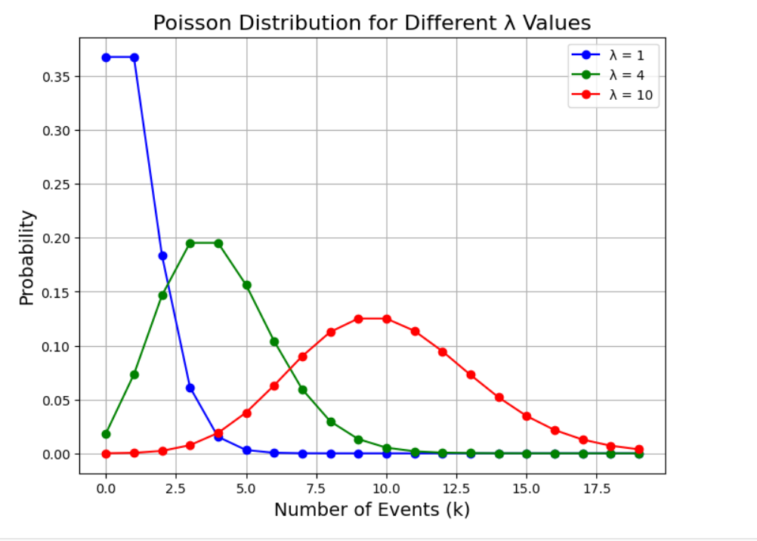
A diagram of the distribution A
plot in the X-Y

